Slide 1
Slow and Fast Atoms: Modeling Strong Field Effects on Yb for Slowing and Quantum Imaging of Magnetic Fields
25th July 2023
Tina Na Narong
PhD Thesis Defense
Advisor: Prof. Leo Hollberg

Slide 2
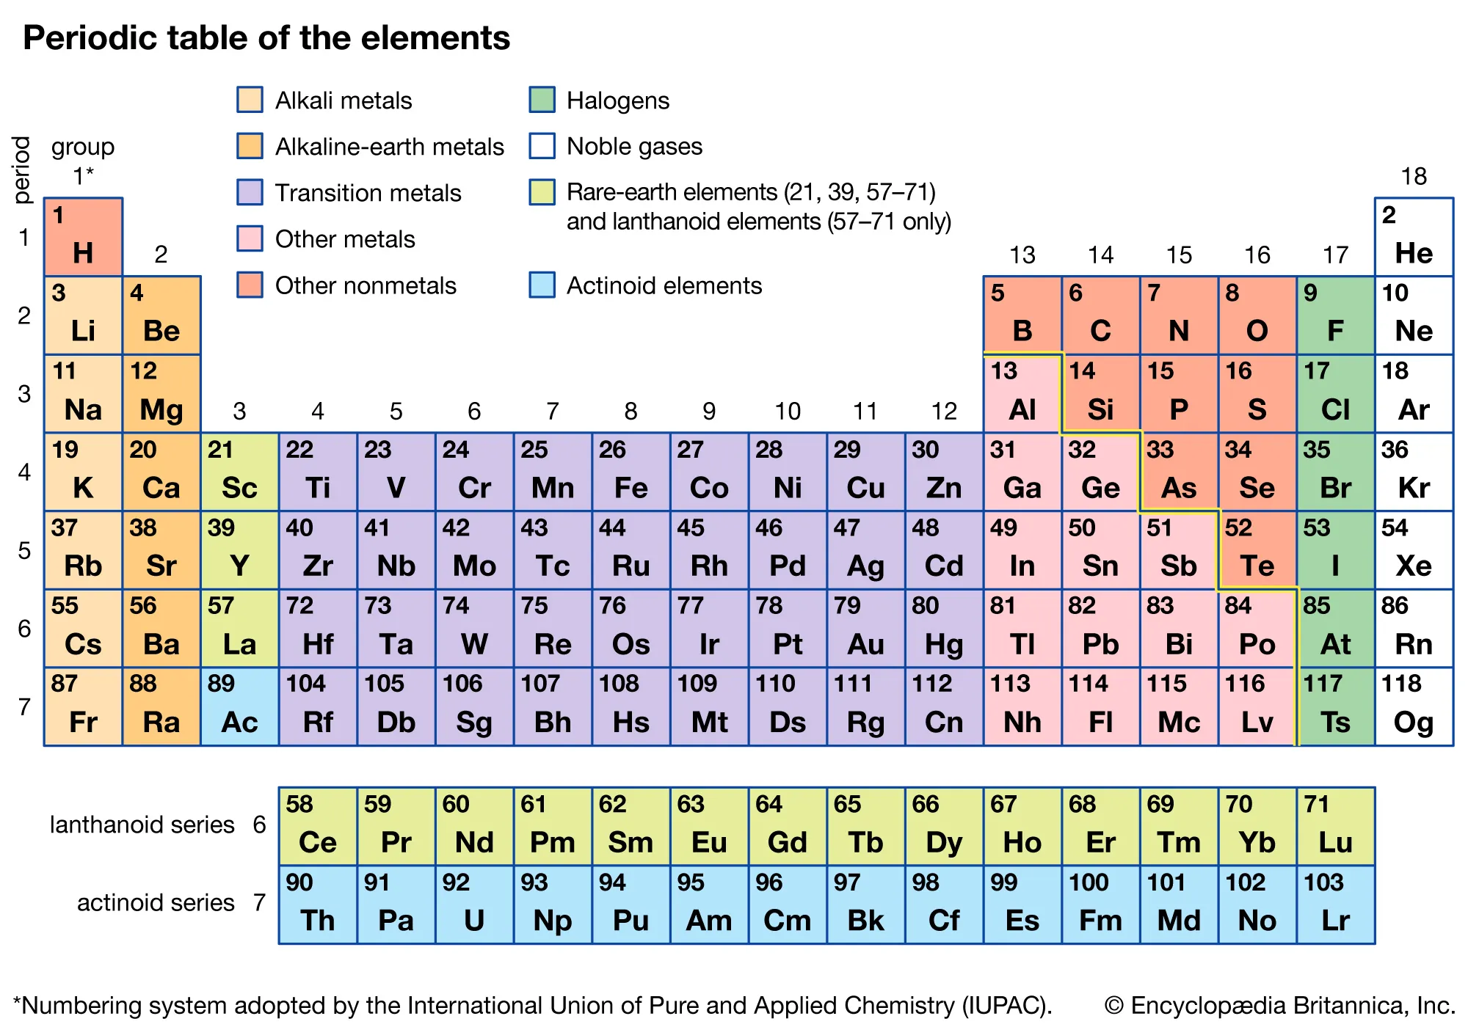
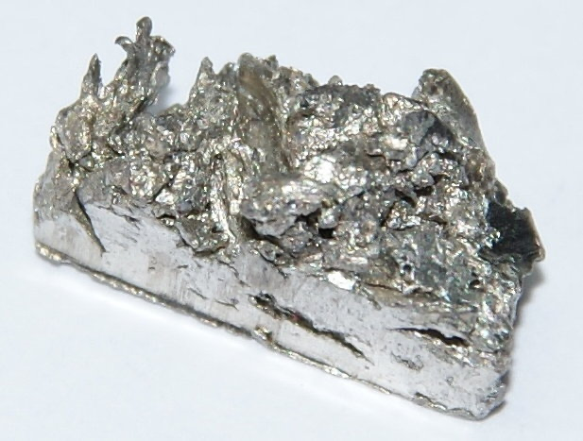

Slide 3
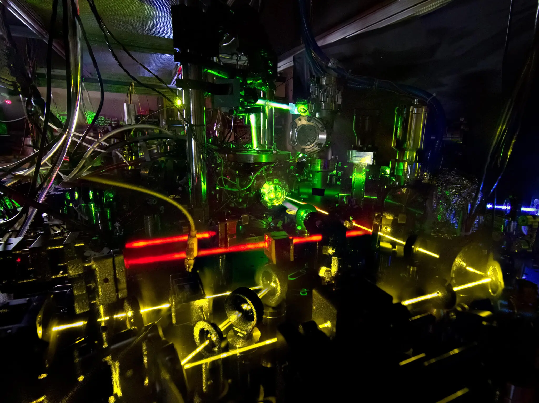

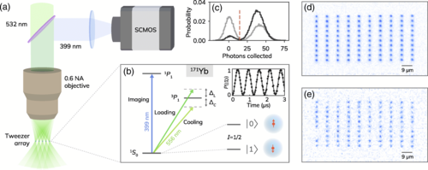



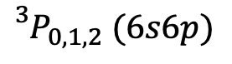
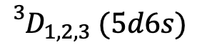
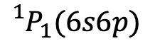

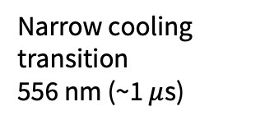
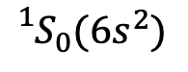
Yb lattice clock at NIST
Stability $≈{10}^{−18}$
(1ps/10 days)
An atom:
Also, an atom (Yb):
$${}_{}^{1}{P_{1}}(6s6p)$$
$${}_{}^{3}{D_{1,2,3} (5d6s)}$$
$${}_{}^{3}{P_{0,1,2} (6s6p)}$$
³P₁
Yb qubits in a tweezer array
Jenkins, et al. PRX (2022)
Electrons orbiting a nucleus (protons + neutrons)
³P₀
Narrow cooling
transition
556 nm (~1 $μ$s)
Ultra-stable
excited state (21 s)
clock transition
578 nm
Yb has 2 outer-shell electrons
$${}_{}^{1}{S_{0}}(6s^{2})$$
ground state
Notes:
A lot of people are excited about the clock transition
But in order to get there, need very cold atoms
So people use this 1S0-3P1 for laser cooling. But in this talk, I’ll show you that we can do more than cooling with this transition.

Slide 4
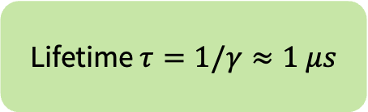
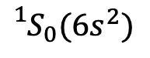
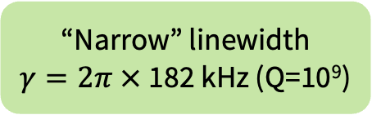
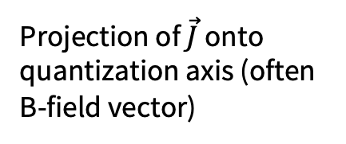
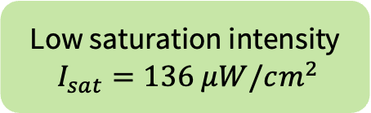
Our protagonist: ¹S₀-³P₁ transition
³P₁ has 3 Zeeman sublevels (J=1)
³P₁ (6s6p)
“Narrow” linewidth
$γ=2π ×$182 kHz (Q=10⁹)
Narrow cooling
transition
556 nm
Projection of $\vec{J}$ onto quantization axis (often B-field vector)
Lifetime $τ=1/γ≈1 μs$
$${}_{}^{1}{S_{0}}(6s^{2})$$
ground state
no hyperfine structure in even isotopes
¹⁷⁴Yb – 31.8%
Low saturation intensity
$I_{sat}=136 μW/cm^{2}$
Notes:
3 sublevels -> show later how we use these to measure magnetic fields
Gamma, tau defines how many decays per second
Low Isat -> practical for strong field effects

Slide 5
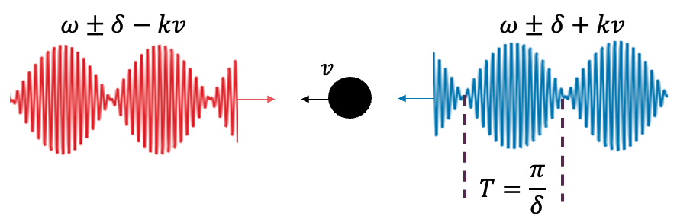

One transition, two ways
Slow atoms
Slow atoms via stimulated emissions using amplitude-modulated light
³P₁ (6s6p)
Narrow cooling
transition
556 nm
Fast atoms
Imaging of magnetic field gradients with atomic fluorescence
$${}_{}^{1}{S_{0}}(6s^{2})$$
ground state

Slide 6
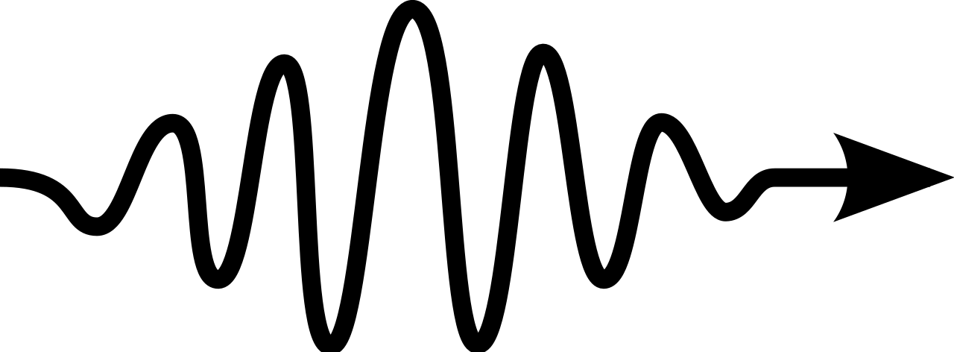
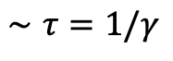
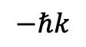
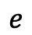
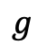

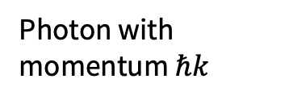
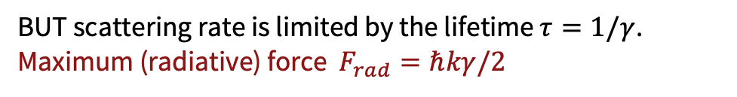
Absorption (and emission) of photons slows atom down
$$∼τ=1/γ$$
$$e$$
Photon with momentum $ℏk$
Do this repeatedly
(very fast)
$$g$$
$$−ℏk$$
Force = momentum change x scattering rate
BUT scattering rate is limited by the lifetime $τ=1/γ$.
Maximum (radiative) force $F_{rad}=ℏkγ/2$
Need large $γ$ for large slowing forces!
SLOW: stimulated slowing
Notes:
an animation of how to slow atoms with laser light

Slide 7

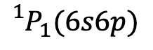
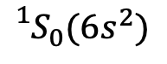
Two-stage cooling: large $γ$ followed by smaller $γ$
$${}_{}^{1}{P_{1}}(6s6p)$$
$${}_{}^{3}{D_{1,2,3} (5d6s)}$$
$${}_{}^{3}{P_{0,1,2} (6s6p)}$$
2nd cooling
556 nm
(182 kHz)
³P₁
1st cooling
399 nm
(29 MHz)
Two-stage cooling:
Need two lasers ($$$)
Lose atoms to “dark states”
$${}_{}^{1}{S_{0}}(6s^{2})$$
ground state
SLOW: stimulated slowing

Slide 8
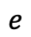
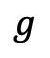
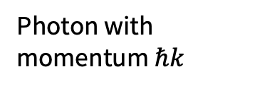
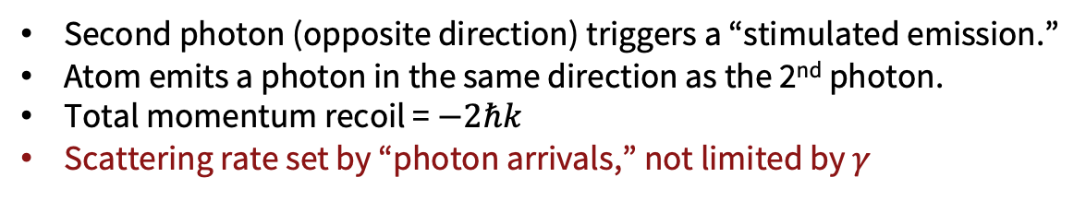
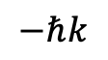
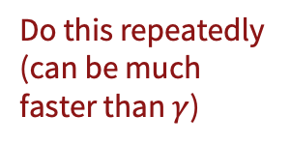
Stimulated emission can mitigate small $γ$
$$e$$
Photon with momentum $ℏk$
Do this repeatedly
(can be much faster than $γ$)
$$g$$
$$−ℏk$$
$$−ℏk$$
Second photon (opposite direction) triggers a “stimulated emission.”
Atom emits a photon in the same direction as the 2nd photon.
Total momentum recoil = $−2ℏk$
Scattering rate set by “photon arrivals,” not limited by $γ$
SLOW: stimulated slowing

Slide 9
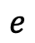
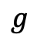
Stimulated slowing using only the ¹S₀-³P₁ transition
$${}_{}^{1}{P_{1}}(6s6p)$$
$${}_{}^{3}{D_{1,2,3} (5d6s)}$$
$${}_{}^{3}{P_{0,1,2} (6s6p)}$$
2nd cooling
556 nm
(182 kHz)
³P₁
1st cooling
399 nm
(29 MHz)
$$e$$
Stimulated slowing + trapping in a 556 nm MOT
2-level atom
$${}_{}^{1}{S_{0}}(6s^{2})$$
$$g$$
ground state
SLOW: stimulated slowing

Slide 10
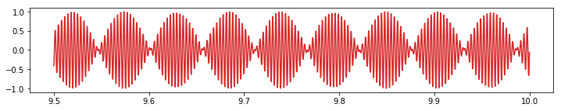
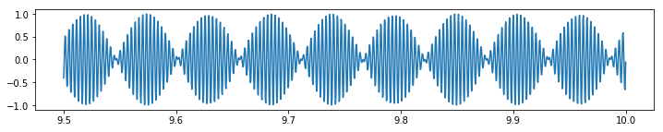
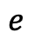
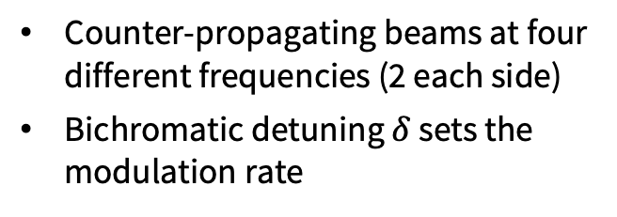
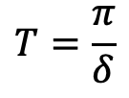
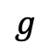
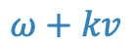
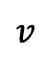
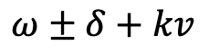
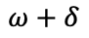

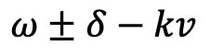
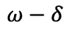
Stimulated slowing with bichromatic light fields
$$ω±δ−kv$$
$$ω±δ+kv$$
$$v$$
$$T=\frac{π}{δ}$$
Lab frame
Atom’s rest frame
$$ω+kv$$
$$e$$
$$ω+δ$$
$$e$$
Counter-propagating beams at four different frequencies (2 each side)
Bichromatic detuning $δ$ sets the modulation rate
$$ω−δ$$
$$ω−kv$$
$$g$$
$$g$$
Grimm et al. (1994), Söding et al. (1997)
SLOW: stimulated slowing

Slide 11
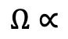
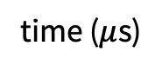
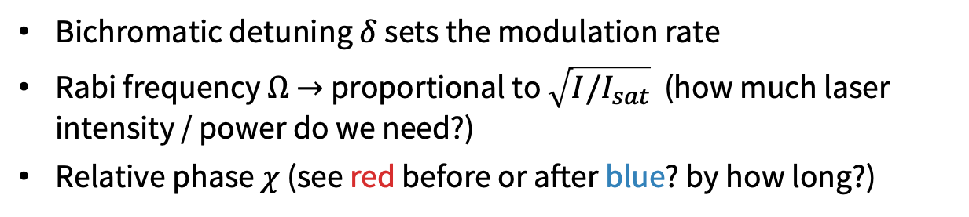
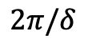
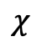
Tune 3 parameters: $δ, Ω, χ$
$$2π/δ$$
$$χ$$
Amplitude
$$Ω∝$$
time ($μ$s)
Bichromatic detuning $δ$ sets the modulation rate
Rabi frequency $Ω$ $→$proportional to $\sqrt{I/I_{sat}}$ (how much laser intensity / power do we need?)
Relative phase $χ$ (see red before or after blue? by how long?)
SLOW: stimulated slowing

Slide 12
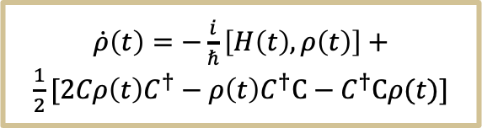





Calculate force numerically (Python)
input
$Ω, δ,χ$, atom’s velocity, position, time
2x2 Hamiltonian with RWA
Solve Master equation
(QuTiP)
Density matrix $ρ(t)$
Hamiltonian$H(z, t)$
Calculate force
$$F(t)=ℏ\frac{∂}{∂z}Tr(ρH)$$
$\dot{ρ}\left(t\right)=−\frac{i}{ℏ}\left[H\left(t\right), ρ\left(t\right)\right]+\frac{1}{2}[2Cρ\left(t\right)C^{†}−ρ\left(t\right)C^{†}C−$ $C^{†}Cρ(t)]$
Force on atom $F(t)$
output
QuTiP: Quantum Toolbox in Python
Johansson et al. (2012) & Johansson et al. (2013)
SLOW: stimulated slowing

Slide 13





Maximize force over a large velocity range (model)
$$F≈90F_{rad}$$
Large force not limited by $γ$
$Ω/δ=\sqrt{3/2}≈1.22$
Relative phase $χ=π/4$
$$F_{BCF}≈\frac{ℏkδ}{π}$$
$\frac{75γ}{k}≈7.6$ m/s
Broad velocity range $≈δ/2k$
(velocity range $≈γ/k$ for $F_{rad}$)
TN*, Liu, Raghuram & Hollberg, PRA (2021)
SLOW: stimulated slowing
Notes:
In order to produce a large force, need these conditions.
Force is large because delta >> gamma
can't use infinitely big delta because we're limited by Omega (laser power)

Slide 14





Slow then trap atoms
Counter-propagating laser beams at 556 nm (green)
Slow atoms from velocities
$>$ 200 m/s to 5 m/s
200 m/s $≈$ 450 mph
Commercial airplanes speed $≈$ 550 mph
Stopping distance for atoms = 33 cm ($≈$ 1 ft)
Deceleration $>$ 6,000g
TN*, Liu, Raghuram & Hollberg, PRA (2021)
SLOW: stimulated slowing
Notes:
this is what it would look like experimentally to slow atoms
the goal here is to trap atoms at 33cm away
the trap has capture velocity of 5 m/s
so whatever velocities the atom has -> it needs tobe 5m/s or slower by the time it reaches the trap

Slide 15
Apply slowing force
Velocity distribution of atoms (N = 20000)
TN*, Liu, Raghuram & Hollberg, PRA (2021)
SLOW: stimulated slowing
Notes:
another challenge here is the velocity range of the atom

Slide 16

Sweep the detuning (chirp)
Velocity detuning (m/s)
Slow enough to be trapped! ☺
time (ms)
Instead of keeping the “center” velocity at 240 m/s, sweep the laser frequency to move the detuning from 240 $→$ 10 m/s.
TN*, Liu, Raghuram & Hollberg, PRA (2021)
SLOW: stimulated slowing
Notes:
Say it’s already 100000x more slow atoms

Slide 17




Optimize for % atoms trapped (MOT loading rate)
Laser beam diameter (mm)
For large bichromatic force:
$Ω/δ$ = $\sqrt{3/2}≈1.2$
Phase $χ=π/4$
Loading rate with 1 W laser power: 0.24%$±$0.03% (95 C.I.)
10¹¹ atoms/s from oven $→$ order of 10⁸ atoms/s trapped in the MOT
To slow atoms:
Chirp from $v_{max}→$ 10 m/s
Chirp rate: every few ms
Budget: 1 W laser power
Need to optimize laser intensity and chirp parameters
% atoms trapped
Larger, less intense
$Ω$ (units of $γ$)
TN*, Liu, Raghuram & Hollberg, PRA (2021)
SLOW: stimulated slowing
Notes:
Beside these parameters
we can choose what frequency sweep parameters to optimize the number of atoms with v < 5 m/s for limited laser power budget

Slide 18







Change the waveform?
$$ω±δ$$
Frequency
time ($π/δ$)
$ω±$ (odd)$δ$
$$2π/δ$$
Frequency
$ω±$ $δ$
$$χ$$
$ω±$ $3δ$
$ω±$ $5δ$
Frequency
$$Ω∝$$
Amplitude
SLOW: stimulated slowing
Notes:
Next question we explored is how the modulation waveform affects slowing force.

Slide 19




Square wave improves velocity range
Square AM force is optimized at different conditions:
 | BCF | Square
$$Ω/δ$$ | $\sqrt{3/2}≈1.2$ | $$π/4≈0.8$$
Phase $χ$ | $$π/4$$ | $$0.36π≈π/3$$
Loading rate with 1 W laser power: 0.40%$±$0.05% (95 C.I.)
1.7X improvement from 0.24% (BCF)
Force (units of $F_{rad}$)
When optimized,
Comparable force to BCF
~2X velocity range
Atom’s velocity (units of $γ/k$)
TN*, Liu, Raghuram & Hollberg, PRA (2021)
SLOW: stimulated slowing
Notes:
did not change order of magnitude

Slide 20




One reason why it improved?
$ω±$ $δ$
$ω±$ $3δ$
Square wave modulation reduces time in the excited state
$ω±$ $5δ$
Frequency
$$e$$
Bloch vector components:
$$v\left(t\right)=i\left(ρ_{01}−ρ_{10}\right)$$
$$w\left(t\right)=ρ_{11}−ρ_{00}$$
$$g$$
Excited-state population
TN*, Liu, Raghuram & Hollberg, PRA (2021)
SLOW: stimulated slowing
Notes:
we looked at this improvement in the velocity domain but we can also look at the time domain

Slide 21



Stimulated slowing – takeaways
Stimulated emission $→$ larger forces (even for small $γ$)
Optimize $Ω, δ,χ$ for force and loading rates (conditioned on laser power)
Force (units of $F_{rad}$)
Atom’s velocity (units of $γ/k$)
Square wave can improve velocity range & loading rate
Slow & trap atoms with only one laser (556 nm) instead of two!
SLOW: stimulated slowing

Slide 22



Square-wave AM light in the transverse direction
A “sheet” of light
Camera
3 mm
30 mm
Yb oven
Atomic beam
Fast atoms
Imaging of magnetic field gradients with atomic fluorescence
Unexpected dark stripes seen on camera
Square wave AM ($δ_{mod}$~MHz)
556 nm light
$≈$5 mm
SLOW: stimulated slowing
FAST: magnetometer
Notes:
beam deflection in the transverse direction
saw dark lines that shouldn't be there

Slide 23





Fluorescence imaging of thermal Yb atoms
Camera
B-field gradient
Yb oven
Atomic beam
$$\vec{B}$$
Square wave AM ($δ_{mod}$~MHz)
556 nm light
y
Laser polarization along y
$$\vec{E}$$
A “sheet” of light
3 mm
z
30 mm
Image plane
x
FAST: magnetometer
Notes:
add the coils

Slide 24

Dark stripes in the fluorescence = magnetic field contours?
x
5 mm
z
FAST: magnetometer
Notes:
gradient from Helmholtz coils + bar magnet

Slide 25



4-level atom
m_{J} = 1
Without B-field
³P₁ (6s6p)
m_{J} = 0
m_{J} = -1
m_{J} = 0
m_{J} = 1
m_{J} = -1
Projection of $\vec{J}$ onto quantization axis (often B-field vector)
556 nm
($γ$ = 182 kHz)
$${}_{}^{1}{S_{0}}(6s^{2})$$
ground state
ground state
FAST: magnetometer
Notes:
change the arrows (mJ)

Slide 26





4-level atom + Zeeman splitting
The ³P₁ state $→$ 3 Zeeman sublevels
With B-field
m_{J} = 1
Zeeman splitting (weak-field) = m_{J}$gμ_{B}|B|$
g = 1.50
$μ_{B}$ (Bohr’s magneton) $≈$ 9.27 x 10⁻²⁴ JT⁻¹
$\left|B\right|$ = magnitude of the magnetic field
Splitting $≈$ 2.1 MHz/Gauss
m_{J} = 0
m_{J} = -1
Zeeman splitting = $gμ_{B}|B|$
Earth’s magnetic field $≈$ 0.5 Gauss
ground state
FAST: magnetometer
Notes:
- Zeeman splitting
- 2.1 MHz/Gauss
How big is 1 G?

Slide 27





Add laser fields
Carrier + odd harmonics
$$δ_{mod}$$
Square wave AM ($δ_{mod}$~MHz)
556 nm laser
$${3δ}_{mod}$$
Carrier + odd harmonics
+ even harmonics
Modulation frequency
$δ_{mod}$ = 1 MHz
FAST: magnetometer
Notes:
let's add laser fields
our square wave modulation will turn the laser on and off
but what we do here is keep the laser on 10% of the time because it gives us more sidebands

Slide 28







Add laser fields
Square wave AM (10% duty)
$ω±$ n$δ_{mod}$
m_{J} = 1
$$Δ_{1}=δ_{mod}$$
m_{J} = 0
Frequency
m_{J} = -1
$ω−$ $δ_{mod}$
$ω+$ $δ_{mod}$
$$Δ_{2}={−δ}_{mod}$$
Baseline model
$$ω$$
Frequency
y
$$\vec{E}$$
Laser polarization along y
Magnetic field along z
(quantization axis)
z
$$\vec{B}$$
x
FAST: magnetometer
Notes:
lots of frequencies to drive the atoms
let's first understand what happens if we have two
and add them one by one

Slide 29








Two resonances: $gμ_{B}B{=±δ}_{mod}$
B-field shifts the $m_{J}=±1$ levels
m_{J} = 1
On resonance: $gμ_{B}B=δ_{mod}$
$$Δ_{1}=δ_{mod}$$
$$gμ_{B}B$$
m_{J} = 0
$$gμ_{B}B$$
2nd resonance: $gμ_{B}(−B)=δ_{mod}$
m_{J} = -1
$$gμ_{B}B$$
$$Δ_{2}={−δ}_{mod}$$
$$gμ_{B}B$$
m_{J} = -1
m_{J} = 0
m_{J} = 1
FAST: magnetometer

Slide 30










Two resonances: $gμ_{B}B{=±δ}_{mod}$
B-field shifts the $m_{J}=±1$ levels
m_{J} = 1
Two resonances: $gμ_{B}(±B)=δ_{mod}$
$$Δ_{1}=δ_{mod}$$
$$gμ_{B}B$$
m_{J} = 0
$$Δ_{2}={−δ}_{mod}$$
$$gμ_{B}B$$
$$Ω_{1}$$
How does total fluorescence change as a function of magnetic field $B$?
m_{J} = -1
Camera sees light emitted in spontaneous emission.
Total fluorescence $∝$ no. of atoms in the excited states
(from density matrix $ρ$)
$$Ω_{2}$$
$δ_{mod}=15γ≈$ 2.7 MHz
Rabi frequencies:
$Ω_{1}=Ω_{2}=Ω∝$ field amplitude
$gμ_{B}B$ (units of $γ$)
FAST: magnetometer

Slide 31


Dark resonances from Autler-Townes splitting
m_{J} = 1
B-field shifts the $m_{J}=±1$ levels
$$Ω_{1}$$
Two resonances: $gμ_{B}B={±δ}_{mod}$
$$Δ_{1}=δ_{mod}$$
m_{J} = 0
Strong fields: AC Stark effect produces Autler-Townes splitting
$$Δ_{2}={−δ}_{mod}$$
$$Ω_{1}$$
m_{J} = -1
$$Ω_{2}$$
“Dark” resonances
Rabi frequencies:
$Ω_{1}=Ω_{2}=Ω∝$ field amplitude
$gμ_{B}B$ (units of $γ$)
FAST: magnetometer
Notes:
more interesting thing happens when the fields are strong
- in this V-system, strong-field AC Stark effect causes these states to split
- we think this is what accounts for the dark lines but it's not the whole story

Slide 32





Fluorescence from moving atoms
Atoms are moving!
Transverse velocity distribution
$gμ_{B}B$ (units of $γ$)
$${−δ}_{mod}$$
$$δ_{mod}$$
10.6 m/s
$gμ_{B}B$ (units of $γ$)
FAST: magnetometer
Notes:
because our atoms are moving

Slide 33









Spatial Hanle effect
With B-field or different polarization
$∝$ Total fluorescence (all directions)
$${−δ}_{mod}$$
$$δ_{mod}$$
Expect no light emitted along y at B=0
$gμ_{B}B$ (units of $γ$)
y
polarized
along y
$$\vec{E}$$
Atom’s electric dipole oriented along y
(without B-field)
Dipole precession in a B-field (B not along y)
z
$$\vec{k}$$
Laser beam propagating along x
Image plane
x
FAST: magnetometer
Notes:
this starts to look like what we have here
but we also need to consider the spatial Hanle effect
orange curve is representative of what we see on the camera

Slide 34



We built a model!
m_{J} = 1
4-level atom + light fields
y
Autler-Townes splitting
$$\vec{E}$$
Laser polarization along y
m_{J} = 0
z
$$\vec{B}$$
$$Ω_{1}$$
m_{J} = -1
x
For moving atoms
+ Hanle effect
$$Ω_{2}$$
$gμ_{B}B$ (units of $γ$)
FAST: magnetometer
Notes:
Now, we have a model!
let's look at some experimental data

Slide 35





More frequencies $→$ more dark lines
Square wave AM (10% duty)
$ω−$ $δ_{mod}$
$ω+$ $δ_{mod}$
$ω±$ n$δ_{mod}$
$$δ_{mod}$$
$${4δ}_{mod}$$
Experiment: square wave AM + sweep $δ_{mod}$
Frequency
Frequency
Any pair of laser fields (sidebands) can produce a dark resonance
10 mm
30 mm
Frequency difference between two fields = integer (n) x $δ_{mod}$
Dark resonance condition: $2gμ_{B}\left|B\right|=nδ_{mod}$
$gμ_{B}\left|B\right|=\frac{n}{2}δ_{mod}=\frac{1}{2}δ_{mod},δ_{mod}$, $\frac{3}{2}δ_{mod}, …$
Data: Hongquan Li
FAST: magnetometer
Notes:
Talk about the nature of the field / how to generate a gradient
- let's go from 2 fields to many fields
- we have a lot of dark lines here that move with delta_mod
- that is because any pair of laser fields can produce a dark resonance
- a series of ladders

Slide 36







Dark lines where $gμ_{B}\left|B\right|=\frac{n}{2}δ_{mod}$
1 MHz
1.5
2.5
2
3
3.5
4
4.5
5
2
3
4
2 MHz
5
4 MHz
2 MHz
B_{z} = 0
1D model: scalar magnetometer
Need $B_{x}, B_{y}$ to explain:
Non-zero intensity at minimum
Missing peaks near minimum
$Δz$ = 0.05 mm
$ΔB≈$ 10 mG (1%) $→$ 1 mG
4 MHz
$gμ_{B}\left|B\right|$ (units of $γ$)
Data: Hongquan Li
FAST: magnetometer
Notes:
draw a line where we take a cross section
scalar magnetometer

Slide 37


2 major sources of background B-fields
Earth’s magnetic field $≈$ 0.5 Gauss
(mainly in xy plane)
Permanent magnet
(built-in Zeeman slower)
FAST: magnetometer
Notes:
Bx and By can come from

Slide 38


2 MHz data + model with $B_{x}, B_{y}$
Square wave AM (10% duty)
$ω±$ 3$δ_{mod}$
Without $B_{x}, B_{y}$
(assume field along z)
Frequency
B_{x} = 0.12 G
Intensity
Non-zero B_{x} : non-zero minimum
z (mm)
z (mm)
FAST: magnetometer
Notes:
without Bx, By
minimum is not at zero and one peak is missing
By adding Bx -> it lifts up this minimum

Slide 39



2 MHz data + model with $B_{x}, B_{y}$
Square wave AM (10% duty)
$ω±$ 3$δ_{mod}$
Without $B_{x}, B_{y}$
(assume field along z)
Frequency
B_{y} = 0.36 G
$$B_{y}≠0$$
Intensity
$$B_{y}=0$$
$$b_{y}^{2}+b_{z}^{2}=r^{2}={\left(\frac{nδ_{mod}}{2}\right)}^{2}$$
Non-zero B_{y} : missing peak
z (mm)
z (mm)
FAST: magnetometer
Notes:
On the other hand, adding By can explain the missing peak

Slide 40

2 MHz data + model with $B_{x}, B_{y}$
Square wave AM (10% duty)
$ω±$ 3$δ_{mod}$
Without $B_{x}, B_{y}$
(assume field along z)
Frequency
B_{x} = 0.12 G, B_{y} = 0.36 G
Intensity
Good agreement with data!
z (mm)
z (mm)
FAST: magnetometer
Notes:
should say that with 1 direction of light + 1 polarization direction
- close to 0.5 G, consistent with the Earth's field

Slide 41



2 MHz data + model with $B_{x}, B_{y}$
Square wave AM (10% duty)
$ω±$ 3$δ_{mod}$
Frequency
Estimate all 3 components
$$B_{z}=\sqrt{{\left|B\right|}^{2}−B_{x}^{2}−B_{y}^{2}}$$
B_{x} = 0.12 G, B_{y} = 0.36 G ($±$0.02 G)
$gμ_{B}B$ (units of $γ$)
z (mm)
FAST: magnetometer

Slide 42







Laser polarization dependence
y
y-polarized light $\vec{E}⊥\vec{B}$
($σ^{+}$ and $σ^{−}$ transitions)
$$\vec{E}$$
Fluorescence ($ρ_{e}$)
m_{J}=1
$$\vec{B}$$
z
$$\vec{k}$$
m_{J}= -1
$$σ^{+}$$
x
$$σ^{−}$$
Laser beam propagating along x
$$gμB (γ)$$
FAST: magnetometer

Slide 43




Laser polarization dependence
y
y-polarized light $\vec{E}⊥\vec{B}$
($σ^{+}$ and $σ^{−}$ transitions)
Fluorescence ($ρ_{e}$)
$$\vec{B}$$
z
$$\vec{E}$$
$$\vec{k}$$
z-polarized light $\vec{E}∥$ $\vec{B}$
(only $π$ transitions)
x
$$gμB (γ)$$
Laser beam propagating along x
m_{J} = 0
2D picture: know when we are parallel to the B-field vector!
$$π$$
m_{J} = 0 level does not shift in B-fields.
FAST: magnetometer

Slide 44






Rotating polarization can tell us about B_{x}, B_{y}
Use Helmholtz coils to cancel background $B_{x}, B_{y}$
Model: B_{x} = 0, B_{y} = 0.1 G
y
$$\vec{E}$$
$$θ=90°$$
$$θ=0°$$
z
Intensity
Fluorescence along y
x
Intensity cross-section
$−gμ_{B}B_{z}$ (units of $γ$)
Data: Josh Tong, Mario Duenas
FAST: magnetometer
Notes:
shrink this so axis label still visible

Slide 45

We have built the first Yb magnetometer!
B-field uncertainty ($ΔB$) | $≈$1 mG (100 nT)
Sensitivity | $≈$10 $μ$G (1 nT) Current camera: 3 ms frame rate provides 15,000 spatially-resolved B-field measurements
Dynamic range | 0 to > 10 T (very large fields!)
Response time | Depends on camera but can be down to 10 $μ$s (lifetime $1/γ≈$ 1 $μ$s)
$B_{x}, B_{y}$ uncertainty (estimate from model) | $≈$20-30 mG
FAST: magnetometer
Notes:
Want to add comparison etc. How do we compare to other magnetometers?
High bandwidth, imaging, vector!

Slide 46
Yb magnetometer - takeaways
Scalar & vector magnetometer
via fluorescence imaging!
Map B-field gradients
Infer B_{x}, B_{y} from model
More vector data via polarization rotation
Intensity
FAST: magnetometer

Slide 47

Future directions (more theses to come!)
More data! (with better control of $B_{x}, B_{y}, B_{z}$)
Improve B-field uncertainty, sensitivity
Determining vector orientation from data (ML?)
Time-domain response – how fast?
Conclusions

Slide 48
We can do more than cooling with this transition! ☺
Slow atoms
Slow atoms via stimulated emissions using amplitude-modulated light
³P₁ (6s6p)
Narrow cooling
transition
556 nm
Fast atoms
Imaging of magnetic field gradients with atomic fluorescence
$${}_{}^{1}{S_{0}}(6s^{2})$$
ground state
Conclusions
Notes:
In conclusion, I hope I've convinced you that beside laser cooling, we can do more interesting physics with this transition!

Slide 49

Questions?

Slide 50

Numerical model (Mathematica + Python)
4 x 4 time-dependent Hamiltonian (after RWA)
Numerically solve Linblad Master Equation (QuTiP) for density matrix. Spontaneous decays are included via collapse operators.
Fluorescence $∝$ excited-state population
Absorption $∝$ Im$\left(χ\right)$, depends on $ρ_{01},ρ_{02},ρ_{03}$
Notes:
To calculate fluorescence and absorption spectra, we can write down a 4x4 Hamiltonian of this system, apply RWA, and solve the Linblad Master Equation numerically for the density matrix.
From the density matrix we can obtain the excited-state population -> which gives us fluorescence
The absorption coefficient for each of the two laser fields can be calculated from the off-diagonal elements of the density matrix.

Slide 51

Calculating fluorescence (total vs along y)
Total fluorescence $∝$ excited-state population $ρ_{e}=ρ_{11}+ρ_{22}+ρ_{33}$
Light emitted along y (our experiment)
Add contribution from m_{J}=0 state (z-polarized light) ${\left|A_{0}\right|}^{2}∝ρ_{22}$
Contributions from $m_{J}=±1$ states (LCP and RCP light adding up to x-polarized or y-polarized light) $\frac{1}{2}{\left|A_{+}−A_{−}\right|}^{2}∝\frac{1}{2}(ρ_{11}+ρ_{33}−ρ_{13}−ρ_{31})$
Total intensity
$$I_{y}∝{\frac{1}{2}\left|A_{+}−A_{−}\right|}^{2}+{\left|A_{0}\right|}^{2}=\frac{1}{2}(ρ_{11}+ρ_{33}−\left(ρ_{13}+ρ_{31}\right))+ρ_{22}$$
Notes:
To calculate fluorescence and absorption spectra, we can write down a 4x4 Hamiltonian of this system, apply RWA, and solve the Linblad Master Equation numerically for the density matrix.
From the density matrix we can obtain the excited-state population -> which gives us fluorescence
The absorption coefficient for each of the two laser fields can be calculated from the off-diagonal elements of the density matrix.

Slide 52

Calculating fluorescence (total vs along x)
Total fluorescence $∝$ excited-state population $ρ_{e}=ρ_{11}+ρ_{22}+ρ_{33}$
Light emitted along x
Add contribution from m_{J}=0 state (z-polarized light) ${\left|A_{0}\right|}^{2}∝ρ_{22}$
Contributions from $m_{J}=±1$ states (LCP and RCP light adding up to x-polarized or y-polarized light) $\frac{1}{2}{\left|A_{+}+A_{−}\right|}^{2}∝\frac{1}{2}(ρ_{11}+ρ_{33}+ρ_{13}+ρ_{31})$
Total intensity
$$I_{y}∝{\frac{1}{2}\left|A_{+}+A_{−}\right|}^{2}+{\left|A_{0}\right|}^{2}=\frac{1}{2}(ρ_{11}+ρ_{33}+\left(ρ_{13}+ρ_{31}\right))+ρ_{22}$$
Notes:
To calculate fluorescence and absorption spectra, we can write down a 4x4 Hamiltonian of this system, apply RWA, and solve the Linblad Master Equation numerically for the density matrix.
From the density matrix we can obtain the excited-state population -> which gives us fluorescence
The absorption coefficient for each of the two laser fields can be calculated from the off-diagonal elements of the density matrix.

Slide 53

















1st & 3rd harmonics ${(δ}_{mod}=20γ)$
With Hanle effect, no light is emitted along y at zero magnetic field.
$$δ_{mod}/2$$
$${3δ}_{mod}/2$$
$$δ_{mod}$$
$${2δ}_{mod}$$
$$δ_{mod}$$
$${3δ}_{mod}$$
$${2δ}_{mod}$$
$${3δ}_{mod}$$
$$−3δ$$
$$−δ$$
$$δ$$
$$3δ$$
$$−3δ$$
$$−δ$$
$$δ$$
$$3δ$$
$$Ω$$
Without carrier
$$Ω$$
With carrier

Slide 54







Fluorescence from atoms with Gaussian velocity distribution (N = 2500)
Fluorescence goes “dark” at $gμ|B|=0, ±δ_{mod}$
Gaussian transverse velocity distribution$σ≈4.5$ m/s
Frac. atoms
Fluorescence ($ρ_{e}$)
$$−δ_{mod}$$
$$δ_{mod}$$
$v_{x}$ (m/s)
B-field uncertainty: 1 mG (100 nT)
Assuming we can detect peaks with 1/1000 precision
$gμB$ (units of $γ$)
Notes:
Add Hanle effect here too?

Slide 55







Beyond the 1D model $→$ vector magnetometer
y-polarized light $\vec{E}⊥\vec{B}$
($σ^{+}$ and $σ^{−}$ transitions)
$B_{z}$ for simulation:
Fluorescence ($ρ_{e}$)
z-polarized light $\vec{E}∥$ $\vec{B}$
(only $π$ transitions)
$$gμB (γ)$$
y
Polarization rotation (from horizontal to vertical)
$$\vec{E}$$
$$θ$$
z
$$\vec{B_{z}}$$
x
Notes:
and here's a quick demo of how the fluorescence image would change as we rotate the polarization

Slide 56

Rotating polarization can tell us about B_{x}, B_{y}
Use Helmholtz coils to cancel background $B_{x}, B_{y}$
Model: B_{x} = 0, B_{y} = 0 G
Intensity
Fluorescence along y
$−gμ_{B}B_{z}$ (units of $γ$)
Data: Josh Tong, Mario Duenas
FAST: magnetometer

Slide 57



Summary
Yb atomic magnetometer: measures B-field using dark lines in fluorescence
Square AM: dark lines where $gμB=0, ±δ_{mod}, ±2δ_{mod}, …$
Visible, fast magnetic field map in a single shot
Vector magnetometer (via laser polarization rotation)
Acknowledgements
Hollberg lab: Hongquan Li, Josh Tong, Mario Duenas, Luz Martinez, Daniel Kuelbs
Funding: NSF Q-SEnSE
Computing: Sherlock cluster @Stanford
Notes:
Finally, I’d like to thank my advisor Leo Hollberg and our group members who helped collect these beautiful data. This project is funded by the NSF Q-SEnSE collaboration.

Slide 58
Line contrast and width depend on optical power
The 3 dips become less resolved at higher Rabi frequencies.
Notes:
The fluorescence curve depends on laser power. Keeping Omega1=Omega2 ranging from 5 to 50gamma.
At lower power we see three nicely resolved dips, then they become less resolved at higher Rabi freq.
This also confirms that the fluorescence is the darkest where magnetic field is zero. (the dark spot on the video)
Now how does this compare to our data?

Slide 59
Power dependence (expt data)
Notes:
The fluorescence curve depends on laser power. Keeping Omega1=Omega2 ranging from 5 to 50gamma.
At lower power we see three nicely resolved dips, then they become less resolved at higher Rabi freq.
This also confirms that the fluorescence is the darkest where magnetic field is zero. (the dark spot on the video)
Now how does this compare to our data?

Slide 60
Power dependence (model)
Notes:
The fluorescence curve depends on laser power. Keeping Omega1=Omega2 ranging from 5 to 50gamma.
At lower power we see three nicely resolved dips, then they become less resolved at higher Rabi freq.
This also confirms that the fluorescence is the darkest where magnetic field is zero. (the dark spot on the video)
Now how does this compare to our data?

Slide 61
Yb optical Quantum Magnetometer: fast, accurate, imaging magnetic fields
Simple system enabling 3D magnetic vector tomography
Dark lines in Yb fluorescence
Are contour lines of constant magnetic field.
Displays magnetic field gradient
Line spacing 2.5 MHz
➔ ΔB = 0.59 Gauss
Performance estimates :
Sensitivity ≈ 10 μG (1 nT) , 3 ms to measure field in 15,000 resolvable pixels
Uncertainty field strength ≈ 1 mG (100 nT).
Dynamic range 0 to 10 T or more?
Response time 10 microseconds feasible.
2-D images a single shot
3-D tomography: will need to raster light perpendicular to the light sheet.
B vector orientation -- rotating polarization
Spatial resolution for the thermal atomic beam ≈ 100 micrometers along the beam and ≈ 15 microns transverse
B-Field zero created by external coil.
Line spacing 1 MHz
➔ ΔB = 0.24 Gauss
3 cm
³P₁ (6s6p)
∆E = 2g_{P1}μB
Camera image of the 556 nm Yb fluorescence viewed orthogonal to the plane that containing the atomic beam and the laser beam
Video measurement times 300 fps
Tina Na Narong, Hongquan Li, Luz Martinez, Daniel Kuelbs, Josh Tong, Mario Duenas
Hollberg Lab, Stanford
Energy
See talk by Tina Na Narong on Thursday
¹S₀
³P₁: 555.8 nm, 182 kHz

Slide 62






Magnetometry applications
G Bison et al. Appl. Phys. Lett. (2009)
Brain & heart activities
Rock magnetization,
magnetic field anomaly
E Boto et al. Nature (2018)
G Vasilakis et al. PRL (2009)
Tests of fundamental physics
$∼$fT/$\sqrt{Hz}$ sensitivity
Notes:
Magnetometry has applications in many fields including geophysics, fundamental physics and medicine

Slide 63








Quantum magnetometers
Atomic magnetometers (K, Rb, Cs)
Measure Larmor precession of spin-polarized atoms in the magnetic field
SERF: spin-exchange relaxation-free $→$ sub fT/$\sqrt{Hz}$ sensitivity (Romalis)
EIT in Rb vapor $→$ vector (Novikova), with imaging (Franke-Arnold)
BEC imaging (Lev)
Other ideas: Hanle effect, optical pumping, nonlinear Faraday effects
Qiu et al. Photon Res (2021)
Cox et al. PRA (2011)
SQUIDs: superconducting quantum interference devices ($∼$fT/$\sqrt{Hz}$)
Diamond NV centers $→$ sub fT/$\sqrt{Hz}$ sensitivity
Notes:
Short summary??? How much to say about different magnetometers?

Slide 64
Contrast as a function of $Ω, δ_{mod}$

